Slide 1



- Topic -
IKEA
CASE STUDY
Presented By-
Name : Suyash Kadu
ID : #21395
Mail ID : Suyashkadu11@gmail.com

Slide 2


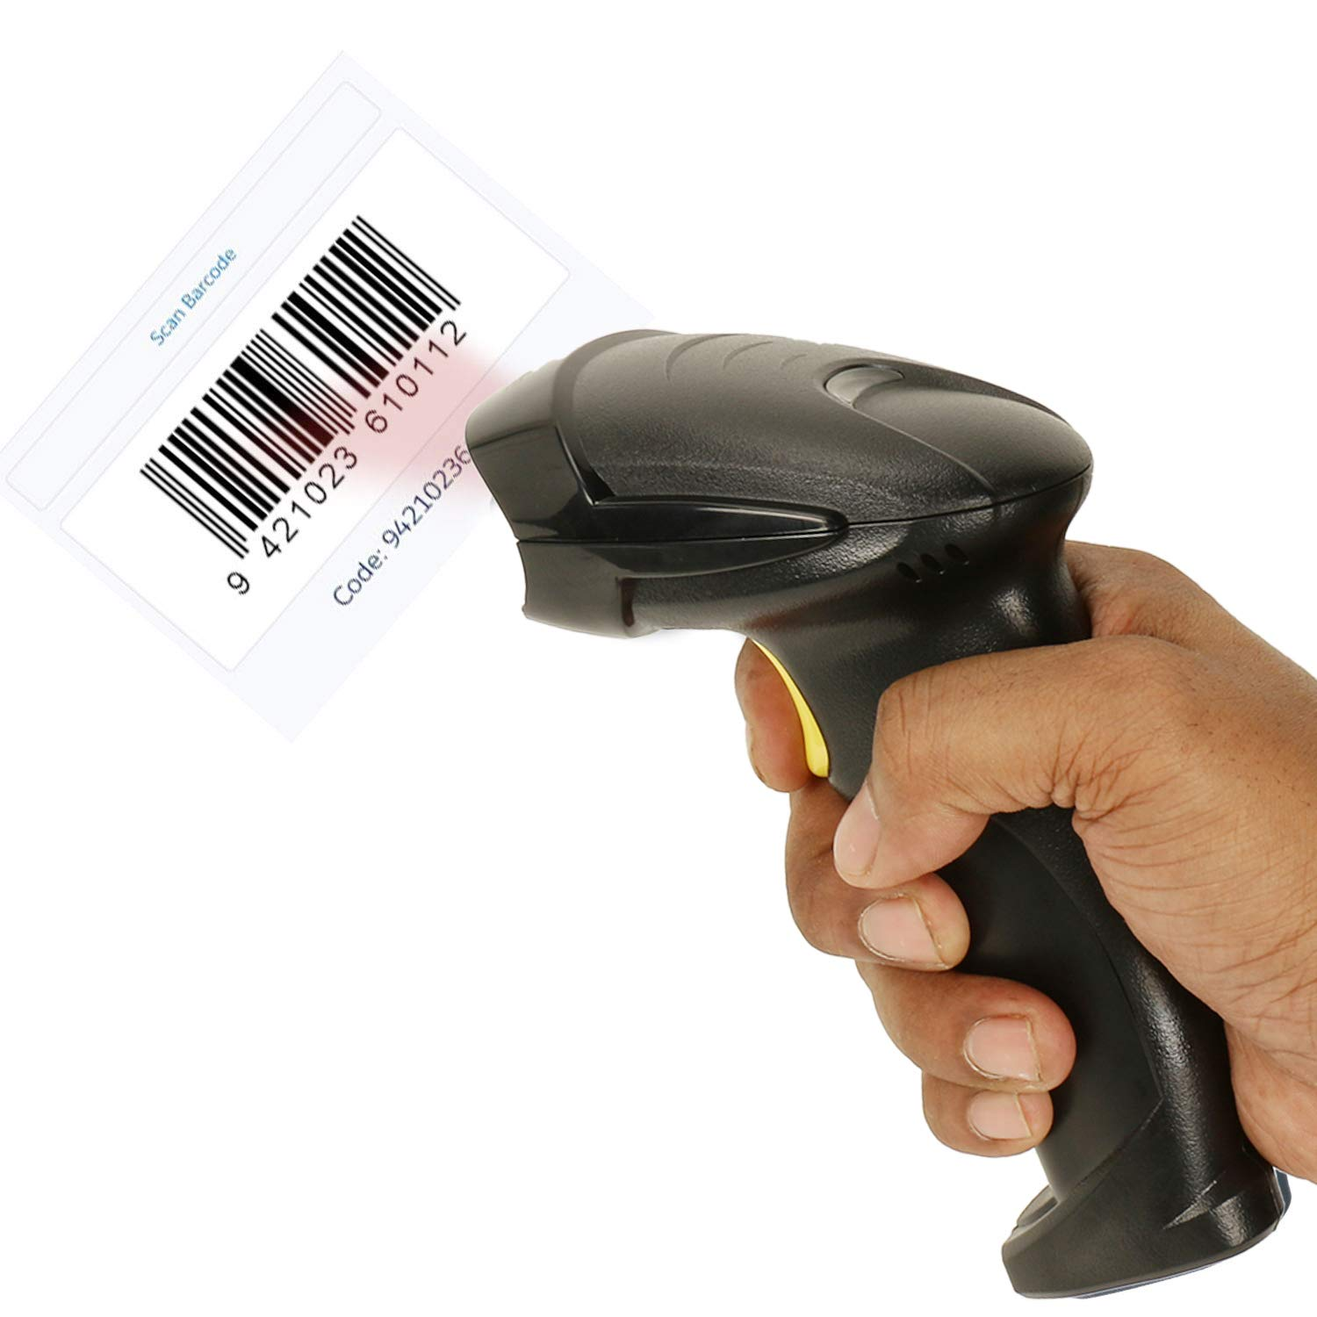







DATA ARCHITECTURE
Barcode Scanner
SQL Server
ODBC (Open Data Base Connectivity)
Power BI Desktop
Power BI Service
Digital Entry

Slide 3


Problem Statement
IKEA wants to optimize its sales by analyzing sales records, customer details, salesperson interactions, supply details, etc. The company wants to:
Monitor sales and profit in different product categories
Track customer requirements and ratings
Monitor delivery details
Check supplier activities
Supervision over Salesperson Activity
Objectives
Customer Review – Identify customer requirements based on their needs, location, and habit. Identify different customer segments based on product category.
Sales and Profit Analysis – Analyze Year-over-Year (YOY) sales and profit, discount, and sales targets by product category and over time.
Delivery Details – Identify delivery lead time, rating, order quantity, and customer feedback to make deliveries more efficient.
Salesperson supervision – Monitor salesperson rating and the total sales done by each salesperson.
Tracking supplier Activities – Identify the quantity supplied by the supplier.

Slide 4
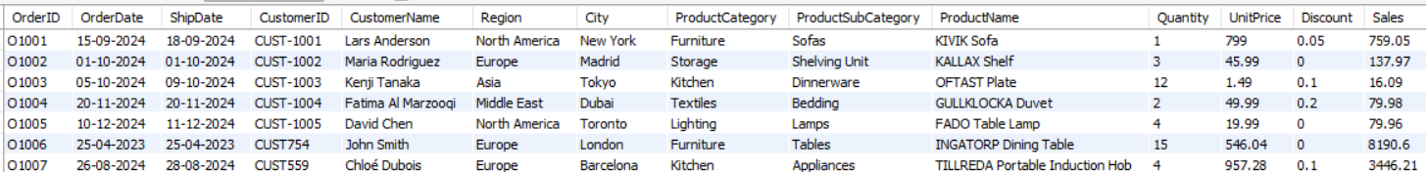
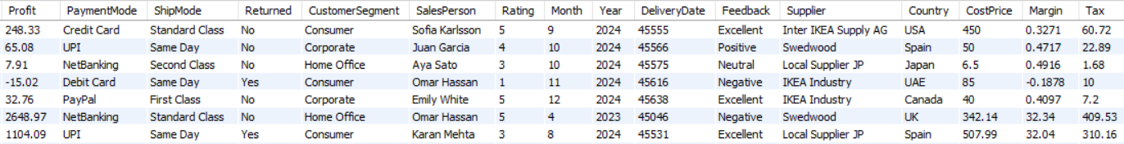
Dataset Overview
In this dataset, we have included 1000 imaginary records consisting of details such as OrderID, OrderDate, ShipDate, CustomerID, Region, City, ProductCategory, Quantity, etc.

Slide 5
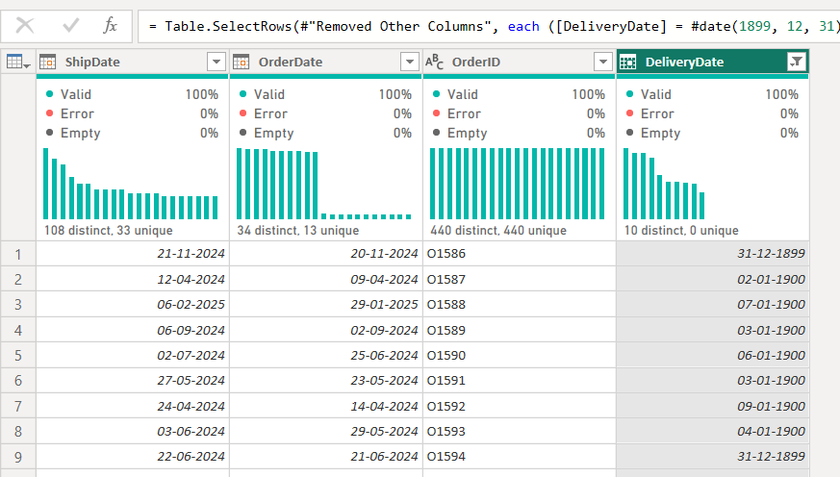

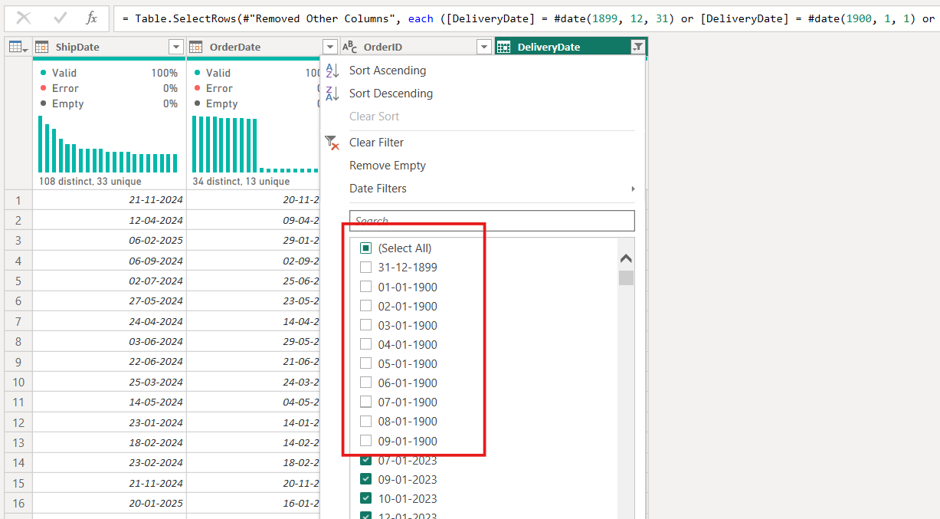
DATA CLEANING
`
“Here Delivery Date is older than order Date which is technically not possible”
“Data cleaning is performed by applying filter on DeliveryDate column”

Slide 6
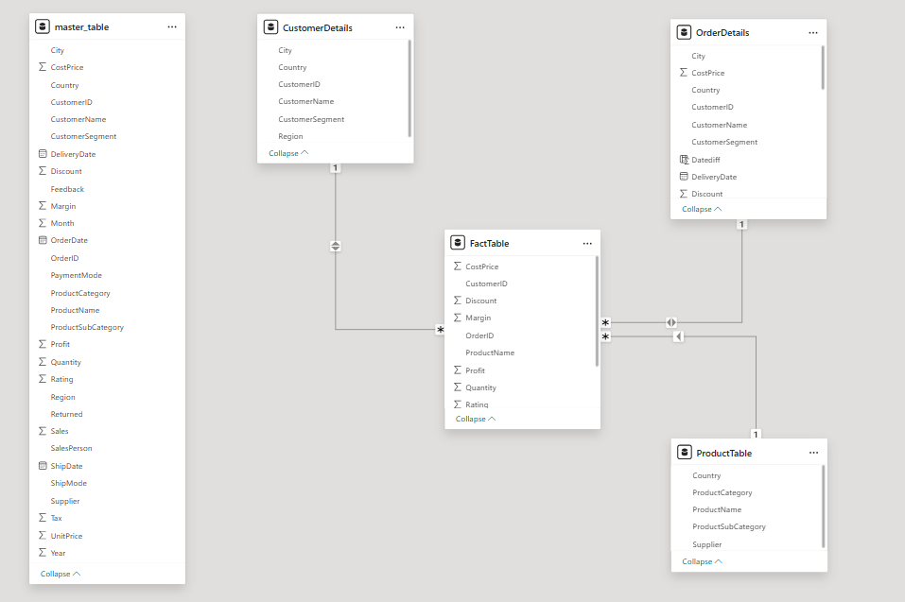
DATA MODELLING

Slide 7
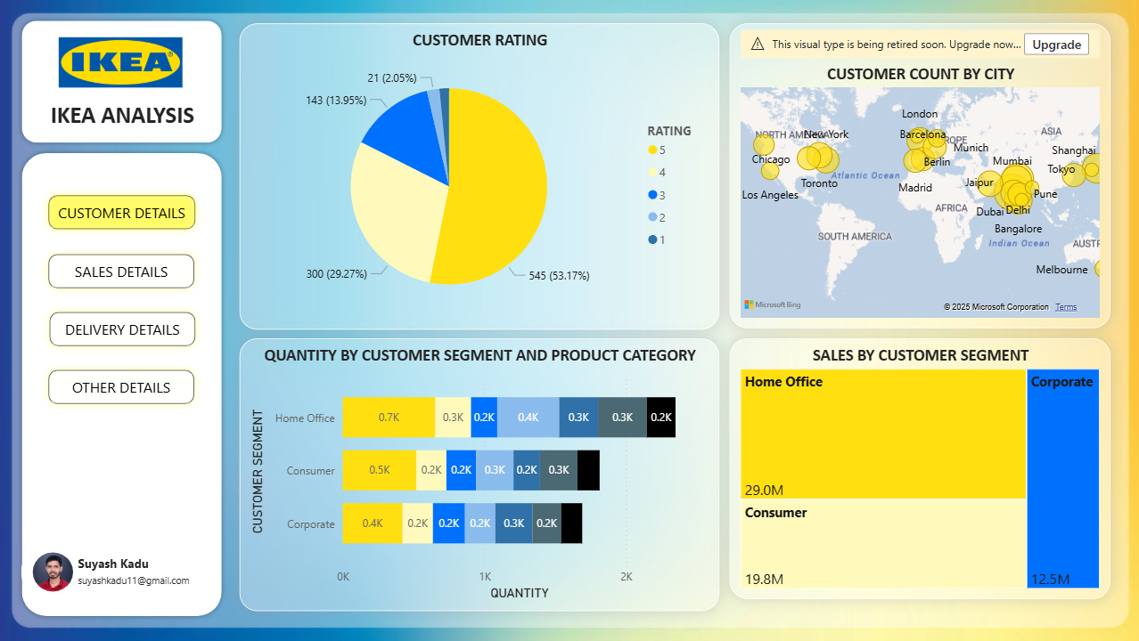
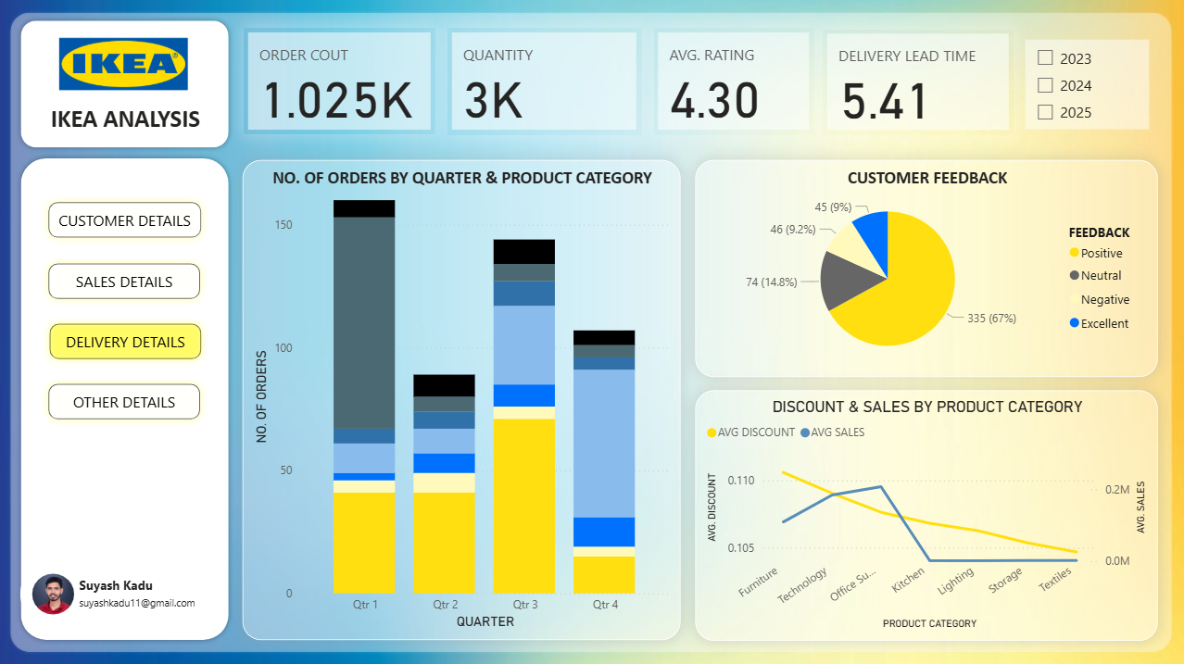
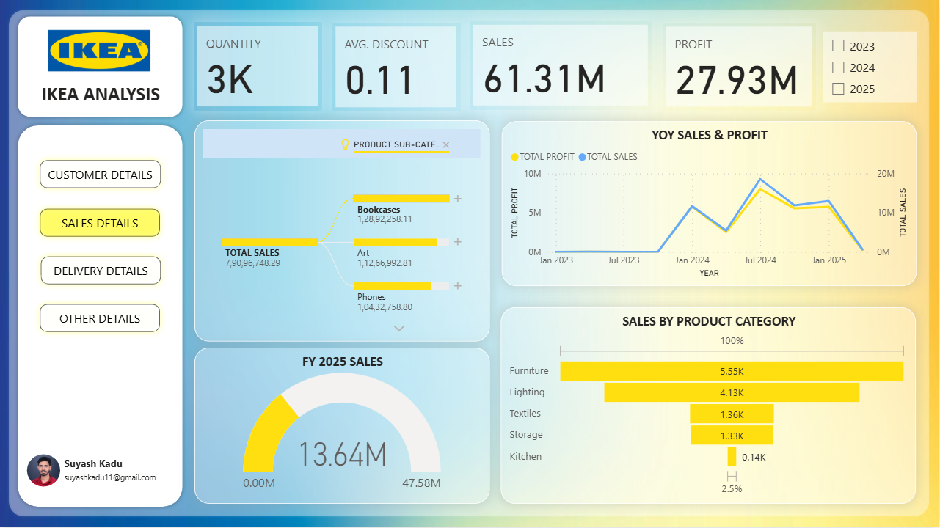
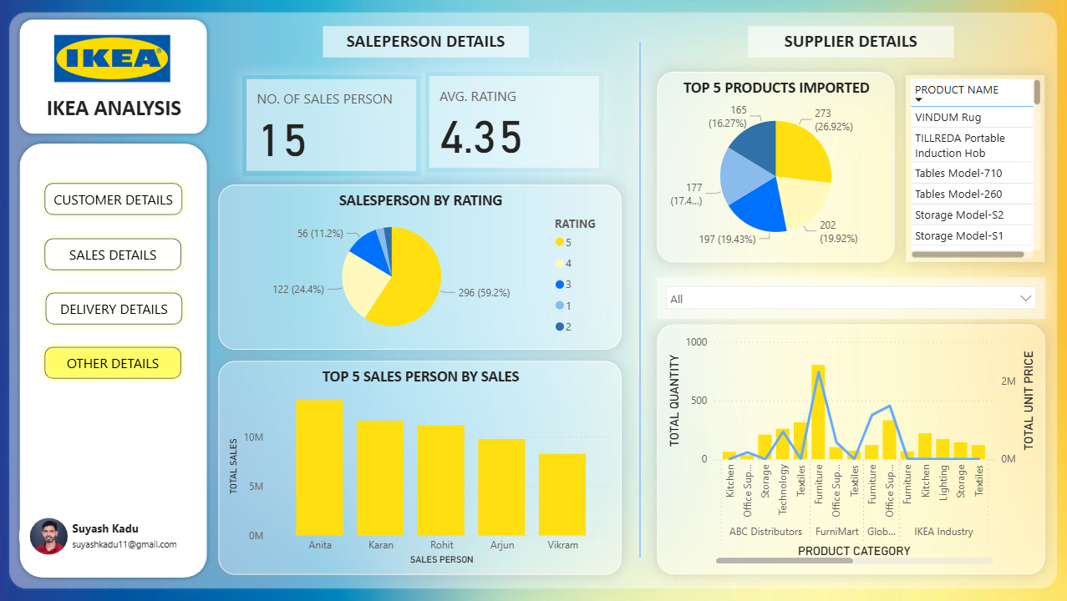
DATA VISUALIZATION

Slide 8

INSIGHTS
Q. Which city gave highest rating (5), and which has the lowest (1)?

Slide 9
INSIGHTS
Q. Which products had the highest and lowest sales in FY 2024, and what was the average discount for those products?

Slide 10
INSIGHTS
Q. In FY 2024 which quarter have highest order for product category ‘office supplies’ ?

Slide 11
INSIGHTS
Q. Identify the Top 5 Salespersons with the Highest Sales and a Rating of 5.

Slide 12
INSIGHTS
Q. Identify the supplier in each product category with a high unit price but a low supply quantity.

Slide 13
CONCLUSION
`
From this dashboard, we can find key insights related to customer ratings, sales, profit, order count, and more. This is achieved by using various visualizations, including pie charts, stacked column charts, line charts, and stacked bar charts.
Additionally, we use slicers for filtering and interacting with data within the dashboard. A thorough process of data cleaning and modeling ensures the quality and accuracy of the data and defines the structured logic necessary for performing meaningful analysis.

Slide 14
- Topic -
IKEA
CASE STUDY
THANK
YOU
Presented By-
Name : Suyash Kadu
ID : #21395
Mail ID : Suyashkadu11@gmail.com

